Slide 1


SHI YUN FOO
11 Feb 2023

Slide 2

Outline
Executive Summary
Introduction
Methodology
Results
Conclusion
Appendix

Slide 3
Executive Summary
Summary of methodologies
Data collection via API and web scraping
Exploratory Data Analysis(EDA) with SQL and data visualization
Visual analytics with Folium
Dashboard with Plotly Dash
Predictive Analysis
Summary of all results
EDA results
Interactive map and dashboard
Predictive results

Slide 4
Introduction
Project background and context
SpaceX advertises Falcon 9 rocket launches with a cost of 62 million dollars while other providers cost upward of 165 million dollars each. Much of the savings is because SpaceX can reuse the first stage. Therefore, this project is to predict if the first stage will land successfully which can be used to determine the cost of a launch to compete against SpaceX.
Problems you want to find answers
What are the main characteristics of a successful or failed landing?
What are the effects of each variables on the outcome of a landing?
What are the conditions which will allow SpaceX to achieve the best landing success rate?

Slide 5

Section 1

Slide 6
Methodology
Executive Summary
Data collection methodology:
HTTP requests to get data from SpaceX API via Python requests library
Web scrapping of Wikipedia via beautifu lsoup library
Perform data wrangling
Replacing null pay load mass with mean mass
Creation of class column to clearly identify successful vs failure landing as training label
Perform exploratory data analysis (EDA) using visualization and SQL
Perform interactive visual analytics using Folium and Plotly Dash
Perform predictive analysis using classification models
How to build, tune, evaluate classification models

Slide 7
Data Collection – SpaceX API
API Data Source 1: https://api.spacexdata.com/v4/launches/past
API Data Source 2: https://api.spacexdata.com/v4/rockets
GitHub Link
API requests call from data source 1 (JSON)
Convert to pandas dataframe
Define function to retrieve additional rocket data from API data source 2 based on data from source 1
Construction of final dataset by combining required columns from the 2 data sources
Filter dataset to only display Falcon 9 data as the final dataset

Slide 8
Data Collection - Scraping
Wikipedia Data Source: https://en.wikipedia.org/wiki/List_of_Falcon_9_and_Falcon_Heavy_launches
GitHub Link
Requests call from Wikipedia URL (HTML)
Beautifulsoup to parse the required HTML table and columns
Convert to pandas dataframe for final dataset

Slide 9
Data Wrangling
GitHub Link
Read data from dataset collected
Generate the list of unique landing outcomes and assign an index to each
Assign index for outcome values containing ‘False’ or ‘None’ to bad_outcomes
Create a landing_class list that assigns ‘0’ to row within ‘bad_outcomes’ index and ‘1’ otherwise
Append landing_class which will be the training label to the original dataset

Slide 10
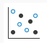
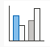

EDA with Data Visualization
GitHub Link
Scatter Plot was used for visualization of relationship between 2 variables and can identify the strength, direction and pattern of the relationship.
Flight Number vs Pay Load
Flight Number vs Launch Site
Flight Number vs Orbit
Pay Load vs Orbit
Bar Chart was used for comparing values across categories
Mean of success rate for different Orbit
Line Chart was used for data trending across a time period
Success rate per year from 2010 to 2020

Slide 11
EDA with SQL
GitHub Link
SQL queries were written to display the following information
Names of the unique launch sites in the space mission
5 records where launch sites begin with the string 'CCA’
Total payload mass carried by boosters launched by NASA (CRS)
Average payload mass carried by booster version F9 v1.1
Date when the first successful landing outcome in ground pad was achieved
Names of the boosters which have success in drone ship and have payload mass greater than 4000 but less than 6000
Total number of successful and failure mission outcomes
Names of the booster_versions which have carried the maximum payload mass
Failed landing_outcomes in drone ship, their booster versions, and launch site names for in year 2015
Rank the count of landing outcomes (such as Failure (drone ship) or Success (ground pad)) between the date 2010-06-04 and 2017-03-20, in descending order

Slide 12
Build an Interactive Map with Folium
GitHub Link
Folium map object was created and centered on NASA Johnson Space Center at Houson, Texas. The following markers were added onto the map
Red circle at NASA Johnson Space Center's coordinate with label showing its name
Red circles at each launch site coordinates with label showing launch site name
Group of points were clustered to display data for multiple launches for the same site with Green icon for successful and Red for failed landing
Lines to show distance between launch site to key locations (coastline, highway, railway, city)
These information can help to visualize the geospatial distribution of the launch sites with their corresponding landing success rate and the potential relationship between the environment/location vs. success rate.

Slide 13
Build a Dashboard with Plotly Dash
GitHub Link
The following components were added to the Plotly Dash dashboard
Dropdown selection box – To allow user to select a specific launch site or all launch sites
Pie Chart – To visualize the percentage of successful vs failed landing
Range Slider – To allow user to specify the range of payload mass
Scatter Chart – To visualize the relationship between landing outcome vs payload mass

Slide 14
Predictive Analysis (Classification)
GitHub Link
Load data to dataframe
Set X to feature dataset and Y to label dataset
Split X and Y into training and test data (test size - 20%)
Perform fitting to ML models using optimized hyperparameters from GridSearchCV
ML models used: Logistic Regression, Support Vector Matrix, Decision Tree, K-nearest nieghbour
Calculate the accuracy of the trained models based on best score and on test dataset
Plot the confusion matrix for the trained models
Evaluate/visualize the confusion matrix and accuracy scores for all models to pick the best model

Slide 15
Results
Exploratory data analysis results
Interactive analytics demo in screenshots
Predictive analysis results

Slide 16

Section 2

Slide 17
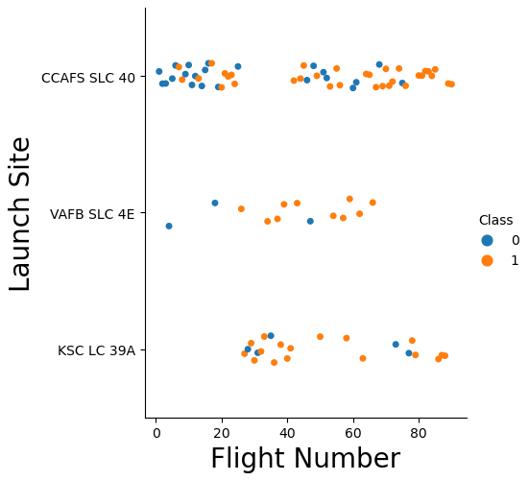
Flight Number vs. Launch Site
Scatter plot:
There is an increase in success rate with higher flight number for CCAFS and VAFB, however it is not as obvious for KSC

Slide 18
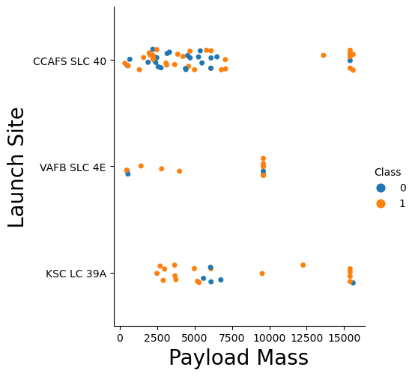
Payload vs. Launch Site
Scatter plot:
There isn’t a clear relationship between payload mass and success rate of landing

Slide 19
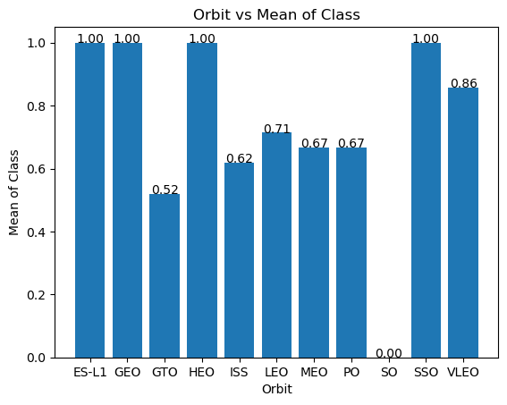
Success Rate vs. Orbit Type
Bar Chart:
ES-L1, GEO, HEO and SSO have 100% successful landing but ES-L1, GEO and SSO has only 1 launch each and hence it is not representative
Among the Orbits with higher number of launches (>5), VLEO has the highest success rate and GTO has the lowest success rate

Slide 20
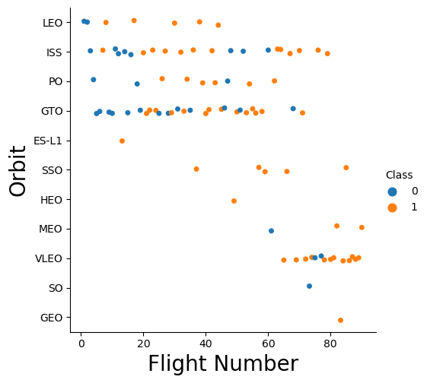
Flight Number vs. Orbit Type
Scatter plot:
There seem to be some relationship between flight number and success rate for LEO
Most of the failures were between flight 0 to 20 when the technology was not as advanced

Slide 21
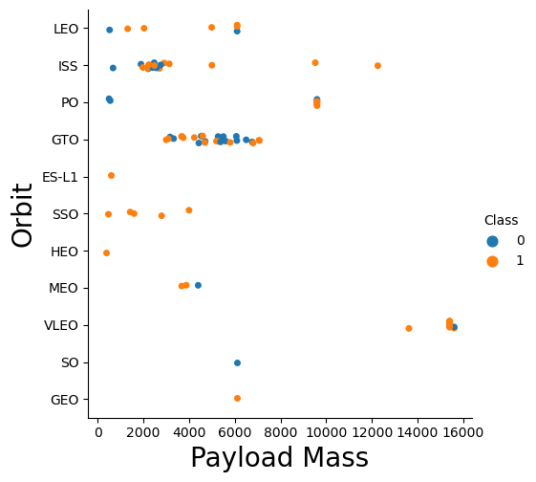
Payload vs. Orbit Type
Scatter plot:
There is a higher success rate at higher payload mass for ISS. However, this relationship cannot be clearly seen for the other Orbits

Slide 22
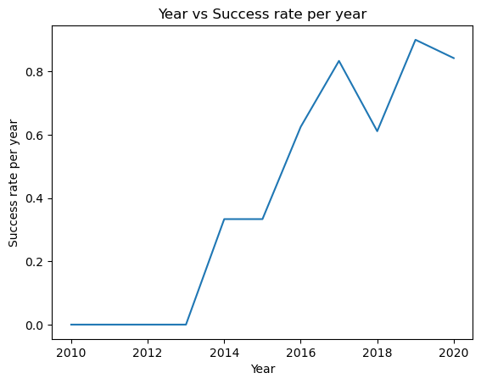
Launch Success Yearly Trend
Line Chart:
The success rate starts to increase from 2013 with a dip in 2018 and 2020. Generally, the success rate is increasing over the years.

Slide 23
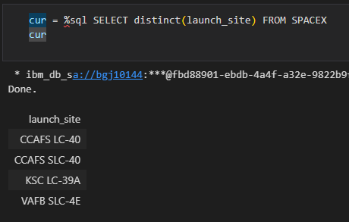
All Launch Site Names
List of all unique launch site. There are only 4 launch sites.

Slide 24
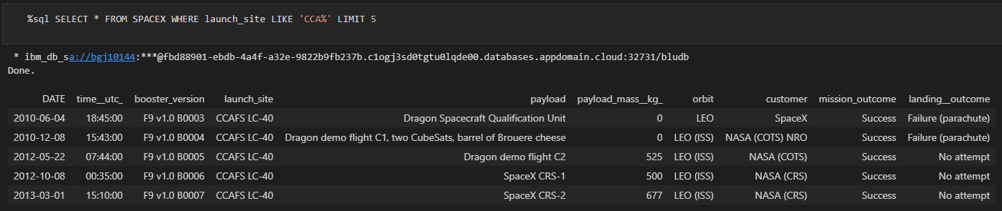
Launch Site Names Begin with 'CCA'
Display 5 records where launch sites begin with the string 'CCA'

Slide 25
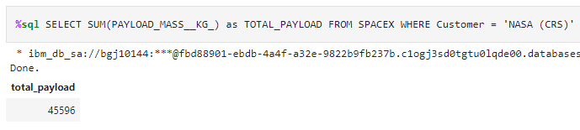
Total Payload Mass
The total payload mass launched by NASA is 45596 KG

Slide 26
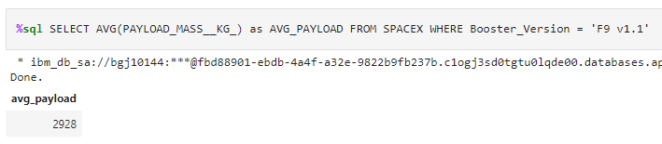
Average Payload Mass by F9 v1.1
The average payload mass carried by booster version F9 v1.1 is 2928 KG

Slide 27
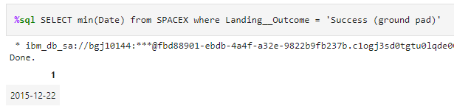
First Successful Ground Landing Date
The first successful landing outcome on ground pad occurred on 22 Dec 2015

Slide 28
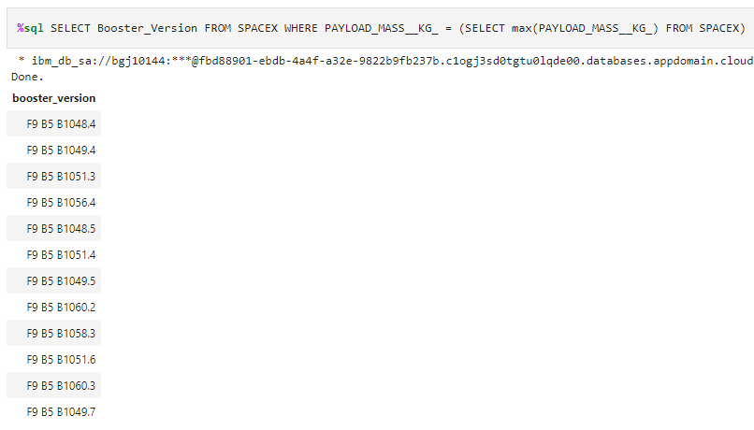
Successful Drone Ship Landing with Payload between 4000 and 6000
Names of boosters which have successfully landed on drone ship and had payload mass greater than 4000 but less than 6000

Slide 29
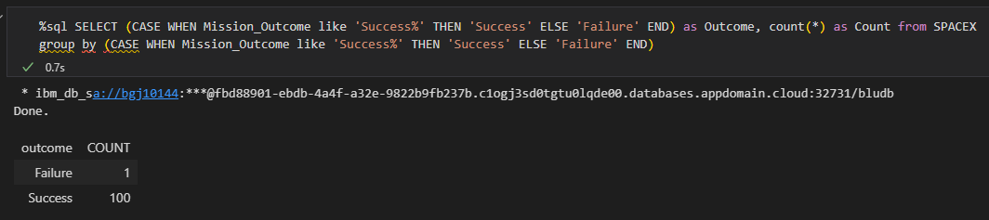
Total Number of Successful and Failure Mission Outcomes
There are 1 failure and 100 success outcomes

Slide 30
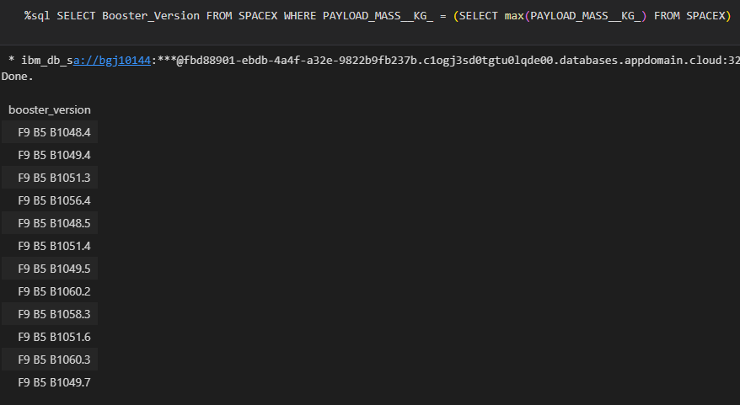
Boosters Carried Maximum Payload
List of booster which have carried the maximum payload mass

Slide 31
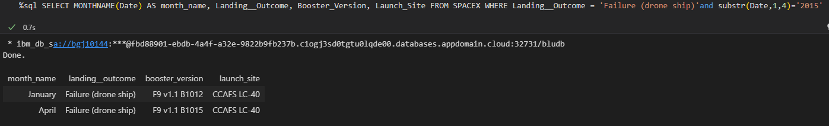
2015 Launch Records
There are 2 failed landing outcomes in drone ship in year 2015

Slide 32
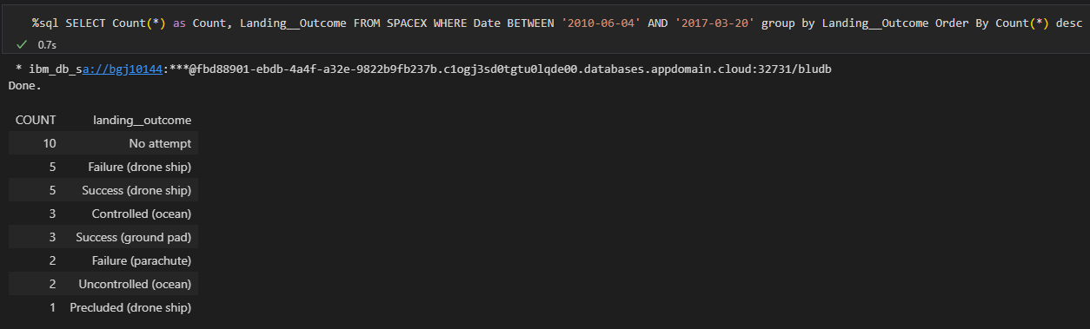
Rank Landing Outcomes Between 2010-06-04 and 2017-03-20
The count of the different landing outcomes was calculated and Failure (drone ship) and Success (drone ship) has the highest count.

Slide 33

Section 3

Slide 34
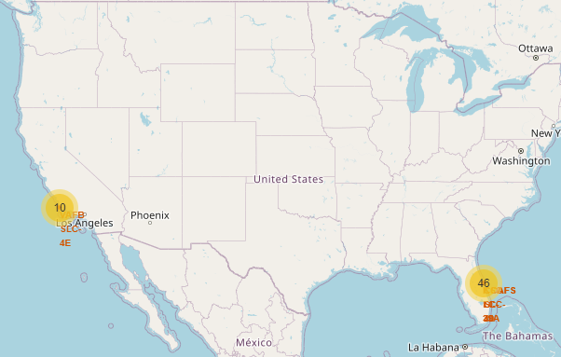
Folium Map Overall SpaceX Geolocation
The launch sites are located near to coast lines

Slide 35
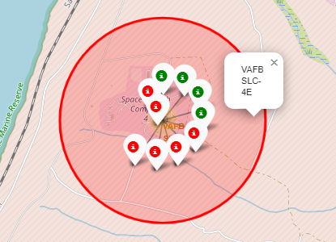
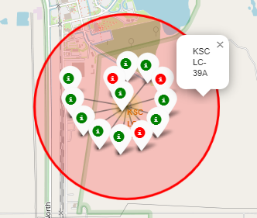
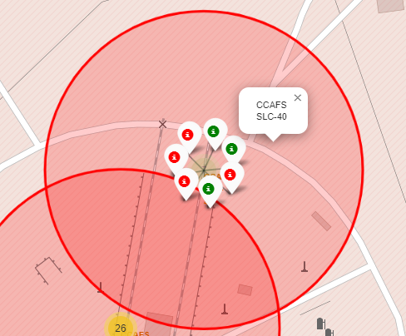
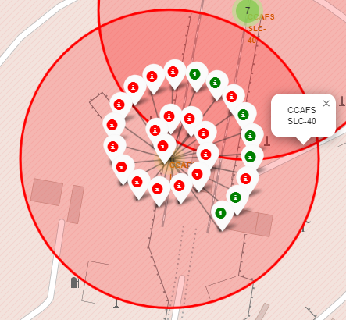
Folium Map – Launch site success rate
KSC LC-39A has the highest success rate
CCAFS SLC-40 has the most number of launches

Slide 36
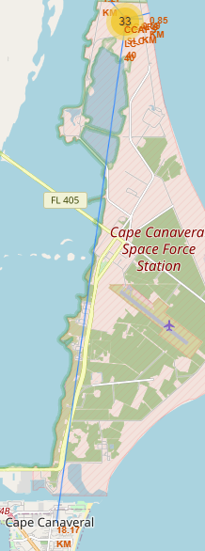
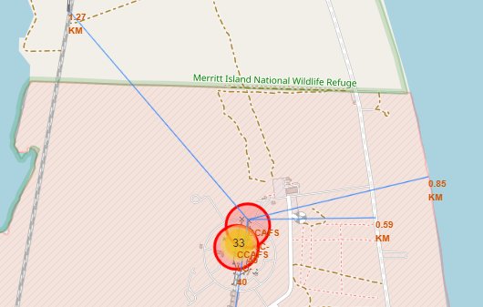
Folium Map – Proximities of launch site
The launch site (CCAFS SLC-40) is close to railways, highways and coastline, but far away from cities

Slide 37

Section 4

Slide 38
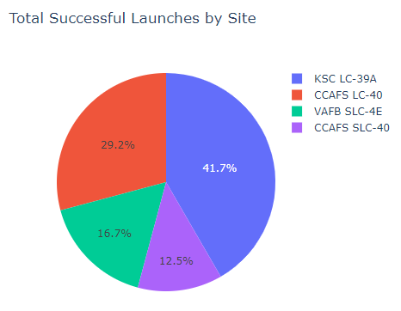
Successful Launches by Site
KSC LC-39A accounts for the highest number of successful launches and CCAFS SLC-40 has the lowest number

Slide 39
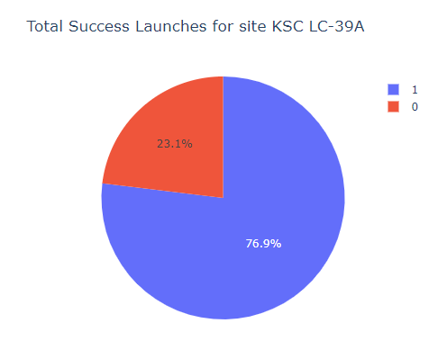
Success rate for KSC LC-39A
KSC LC-39A has a success rate of 76.9%

Slide 40
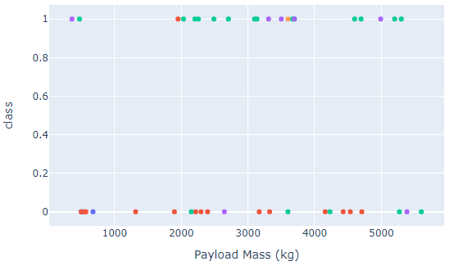
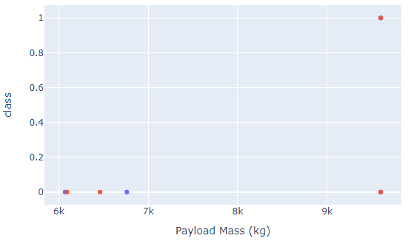
Distribution of success/failures across payload mass
Payload: 0 to 6000 KG
Payload: 6000 to 10000 KG
There are only a few launches with payload above 6000 KG.
There seems to be a higher occurrences of successful landing at payload below 6000 KG.

Slide 41

Section 5

Slide 42
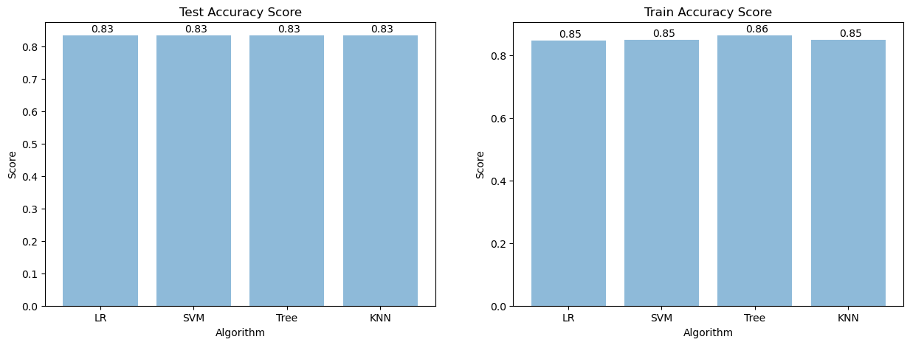
Classification Accuracy
From the bar charts above, we can see that all models have the same test accuracy and decision tree model has a slight edge in scoring 0.01 higher than the other models for train accuracy.
All models performed very similarly and the best model would be decision tree.

Slide 43
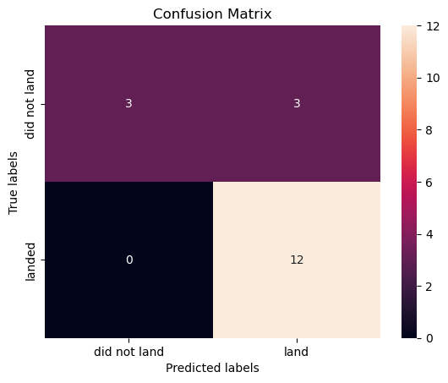
Confusion Matrix
Confusion Matrix for Decision Tree Model
The model is able to distinguish between the different classes with some risk of having false positives

Slide 44
Conclusions
There is a general trend that the success rate increases with increasing flight number and over years. This is probably due to the advancement in technology and methods over the years based on lessons learnt from the previous flights.
Generally lower payload mass also contributes to higher success rate, probably due to an easier rocket control with lower overall mass. However, ISS has a higher success rate at higher payload mass.
Among the Orbits with higher number of launches (>5), VLEO has the highest success rate and GTO has the lowest success rate. Further study on VLEO can be performed to deep dive on the success factors.
There is a preference to locate launch sites near coast lines and away from the cities so that sea landing could be planned easier and for the safety purposes.
All classification models performed very similarly with Decision Tree performing slightly better for train accuracy. Hence Decision Tree model could be adopted.

Slide 45


